Slide 1
Bs –JS : Components
Html
Css
Js : validation plus send user and pass to server to authenticate
- Reusability :
Index.html
username
userpass
contact.html
login
cancel

Slide 2
BS Components :
Alerts
Carousel : like slide show
Modal , modal dialog
Drop down menus
…….

Slide 3
Alert : classes for css : alert , alert – success , .. Contextual classes for alert , alert-link
Pure js :
Select close button
Register click
Event handler : function : remove alert
Bs.js
Using data attributes : gain functionality within bs .js

Slide 4
Data-attributes : listen for events
Data-dismiss : closing
Data-toggle : toggle ( dropdown , collapse , modal , ….)
Data-slide-to
Data-slide ….
Using predefined attributes for bs ( data-

Slide 5
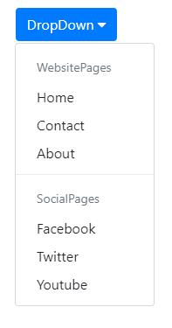
Dropdown menues
2- Change direction for drop down menu :
Display drop down left or right toggle :
From getbootstrap.com
Task
1- change text with font awesome icons : links

Slide 6
forms
task
1- form –group
Form-control
Iput-group
Input-group-append
Input-group-prepend
Input-grop-text
Custom-select
Custom-select-lg
Custom-select-sm
1-Inline-form
2- validation classes for bs with form controls :

Slide 7
products
card
Card : organized container :
Card header
Card-body
Card-footer
Card-header
Card-body
Card-footer

Slide 8
CARDS
tasks
Card – pills
Card – tabs

Slide 9
Collapse : data-toggle=“collapse

Slide 10
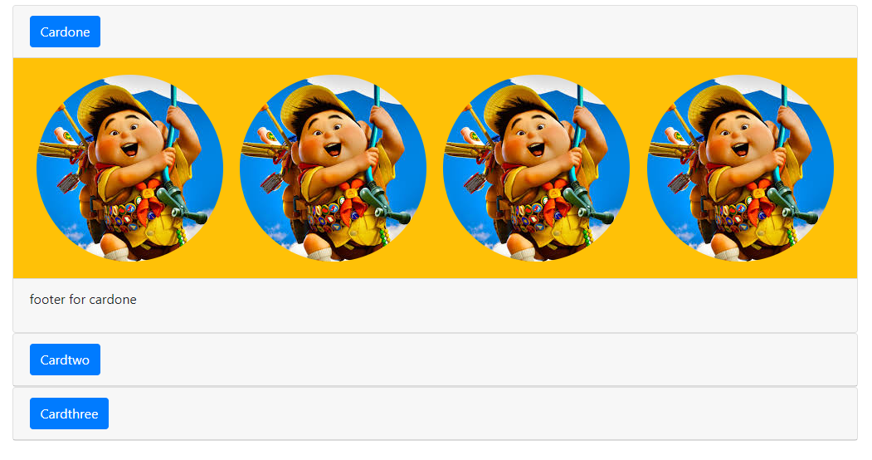
task
transform

Slide 11
Modal : pop windows : user , pass
login

Slide 12
modal
modal
modal : organized container :
modal header
modal-body
modal-footer
By default modal hidden
Modal appearance : popup
modal-header
Modl-content
modal-body
Modal-dialoge
modal-footer

Slide 13
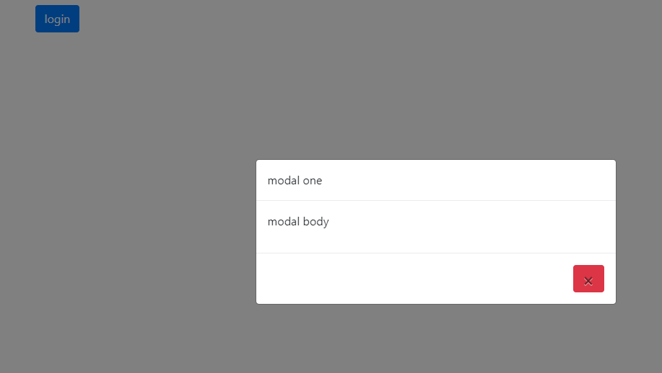
task
1- dismiss modal
2- take user name , pass
Validation using bootstrap
Just dismiss modal
Username : nasr
Userpass:123
login

Slide 14
Carousel : slide show
Carousel-inner
Contains set of carousel-items
Every item contains : image and content text : caption
text
Carousel-controls
Carousel-indicators
carousel

Slide 15
Carousel classes and attributes
Class :
Carousel
Carousel-inner
Carousel-indicators
Carousel-control-prev
Carousel-control-next
Slide
active
attributes :
Data-target
Data-slide-to
Data-slide
Data-interval
Data-ride

Slide 16
navbar
carousel

